Slide 1




My life as an Early Career Researcher
UK Energy Storage Conference 2019
5 September 2019
Parisa Akaber
Knowledge Transfer Partnership Associate
Newcastle University/SIEMENS Future Grid

Slide 2
Overview
UK Energy Storage Conference 2019
5 September 2019
My background
Education
Work Experience
How did I end up here!
What am I working on as an Early Career Researcher?
My KTP Project
Responsibilities and challenges
Lesson learned!

Slide 3

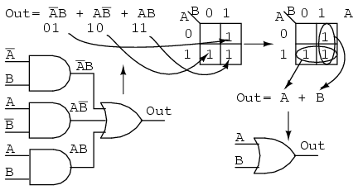

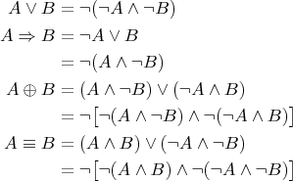
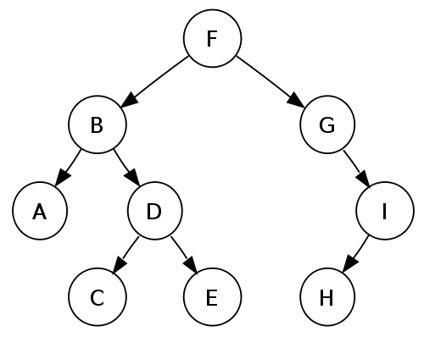
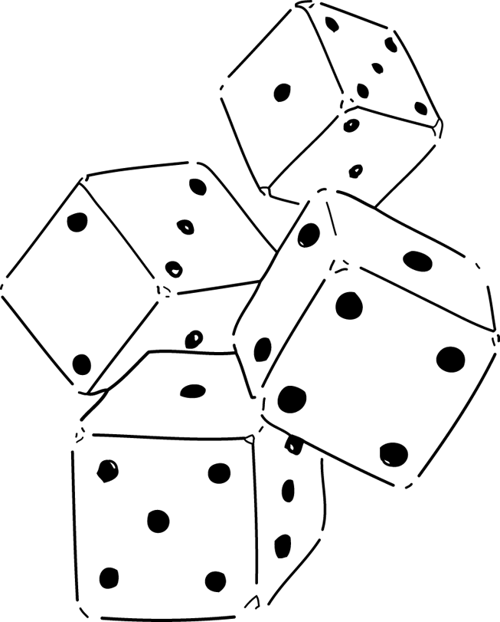
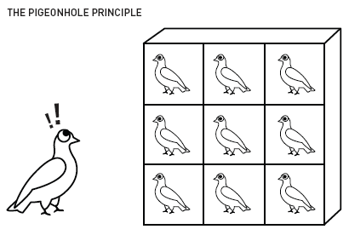
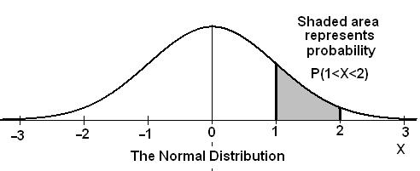
Undergraduate Studies
UK Energy Storage Conference 2019
5 September 2019
Bachelor’s degree in Computer Engineering
Digital Circuit logics
Discrete Mathematics

Slide 4

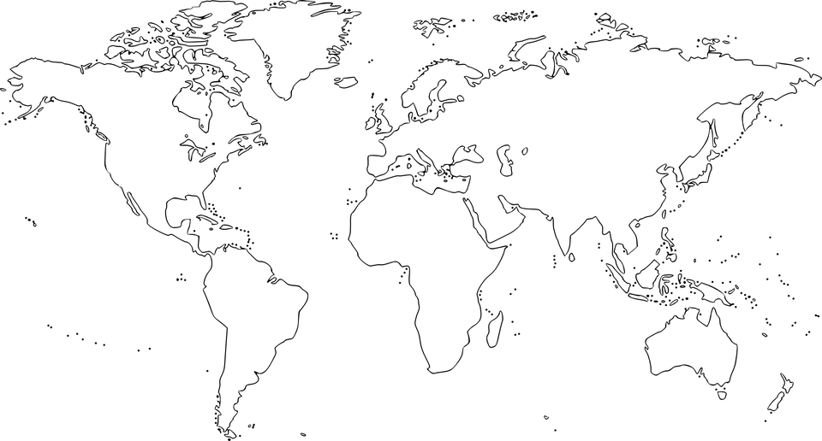


Moving to Canada!
UK Energy Storage Conference 2019
5 September 2019

Slide 5



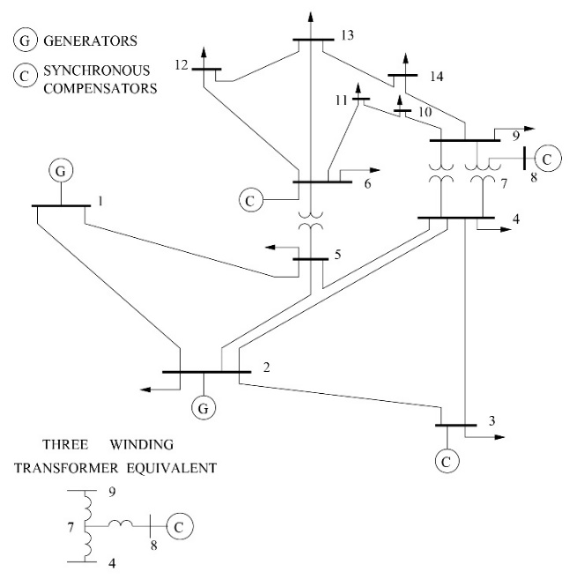
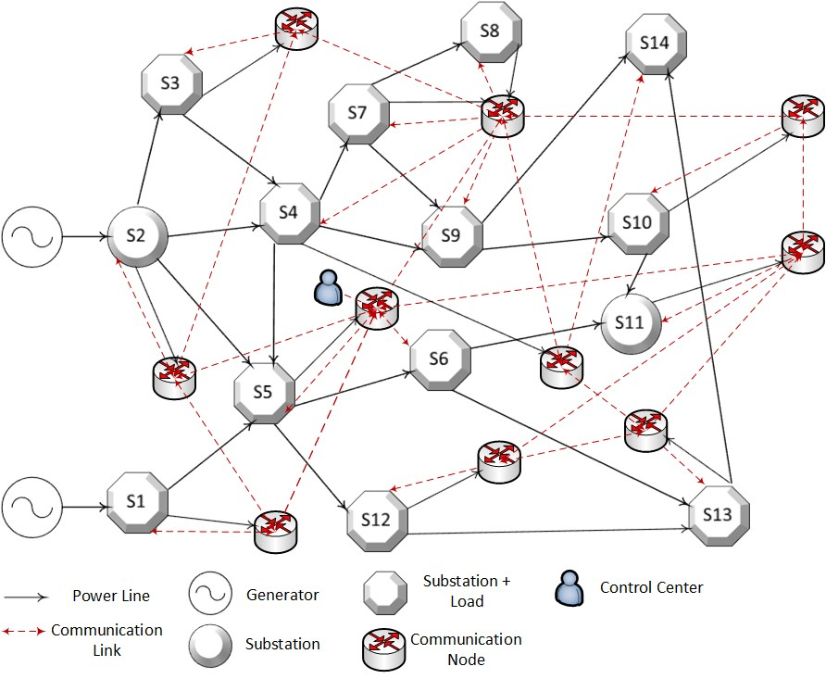
Master’s Studies
UK Energy Storage Conference 2019
5 September 2019
MSc. Information Systems Security
Smart Grid vulnerability assessment and security metric deployment
How to represent a complex coupled power-communication network into mathematical equations
What are the most critical components in the system?
How to optimally allocate protection resources to maximize system resilience?
How to minimize the restoration time after a service interruption?

Slide 6




Moving to the UK!
UK Energy Storage Conference 2019
5 September 2019

Slide 7




KTP Associate Newcastle University SIEMENS Future Grid
UK Energy Storage Conference 2019
5 September 2019
Knowledge Transfer Partnership
Real world problem
Knowledge and Expertise
Higher Qualification Opportunity:
Started PhD in Newcastle University Power System Group

Slide 8

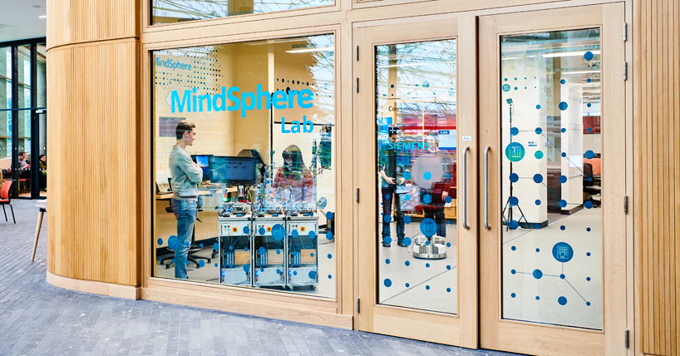
KTP Associate Newcastle University SIEMENS Future Grid
UK Energy Storage Conference 2019
5 September 2019
Developing an E-depot Smart Charging Scheduling and E-Fleet Management Solution
Data-driven integrated optimization platform
Considering Economical and Technical aspects of operating an e-fleet
Scalable solution for large e-fleets

Slide 9
KTP Associate Newcastle University SIEMENS Future Grid
UK Energy Storage Conference 2019
5 September 2019
Knowledge Transfer Partnership
Appreciate the opportunities!
Associate Responsibilities:
Problem Solving
Research Novelty
Act as a bridge between Academic and Industry partner
Act as Industry and Academia representative
Managing my own research project
Project progress, Time Management
Budget Management
Identify required training
Resource Management
…
Project Management!
Time management
Identify the needs
Learn the differences:
Sales Pitch
Academic Presentation
Learn the language!
Identify the common interest!
Learn how to find short-term solutions! (maybe sacrifice precision at first)

Slide 10
KTP Associate Newcastle University SIEMENS Future Grid
UK Energy Storage Conference 2019
5 September 2019
Knowledge Transfer Partnership
What I have learned as an Early Career Researcher?
Always Ask!
Seek mentoring!
Network
Collaboration
Shake hands
Personal Development
vs
Career Development
Differences between academic and industrial mindset!
Expectations
Objectives
Try to accept various responsibilities
(out of my comfort zone)!
Do not be afraid
Leverage Opportunities!
Training
Presentation (feedbacks)
How to start simple and add complexity over time!
Get work done!

Slide 11
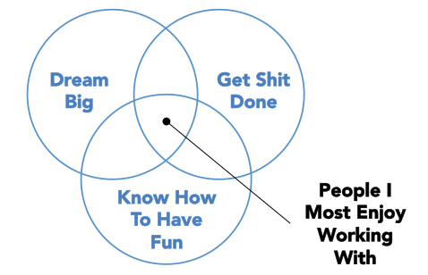
KTP Associate Newcastle University SIEMENS Future Grid
UK Energy Storage Conference 2019
5 September 2019
Knowledge Transfer Partnership
WORK
Jeff Weiner (CEO of LinkedIn) on Twitter

Slide 12

UK Energy Storage Conference 2019
5 September 2019

