Slide 1
A New Ontology Lookup Service at EMBL-EBI
Tony Burdett
Technical Co-ordinator
Samples, Phenotypes and Ontologies Team

Slide 2

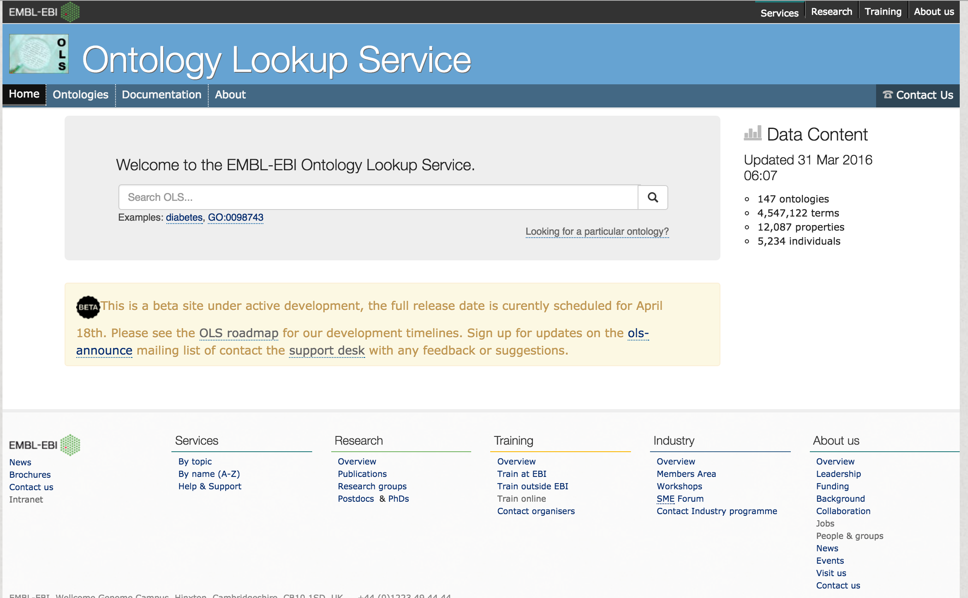

OLS Bug Hunt
http://goo.gl/BKVCIE
http://www.ebi.ac.uk/ols/beta

Slide 3
Why we need a new OLS
Old codebase (+10 years in places)
  Dependencies on retired libraries e.g. Apache OJB
Built around OBO format (outdated parser)
  OBO has largely been superseded by W3C OWL format (OBO is now a subset of OWL)
Built around an assumption that ontologies are available in public VCS (CVS or SVN)
Assumes one term in one ontology
Uses Oracle RDMS and SQL for querying ontology structure (suboptimal)
SOAP API + XML out of favour – Developers want REST/JSON

Slide 4
OLS 3.0
Rebuilt from scratch
Polls ontologies by URL
  Server side checksum for detecting changes in files
Uses Java OWL API for loading (still supports OBO)
RESTful API built with Spring Data
Multiple indexes for scalable querying (micro services architecture)
  SOLR server – text queries
  Neo4J server – graph queries
  Virtuoso server – SPARQL (RDF/OWL queries)

Slide 5
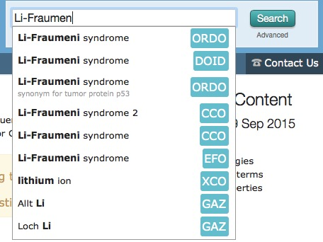
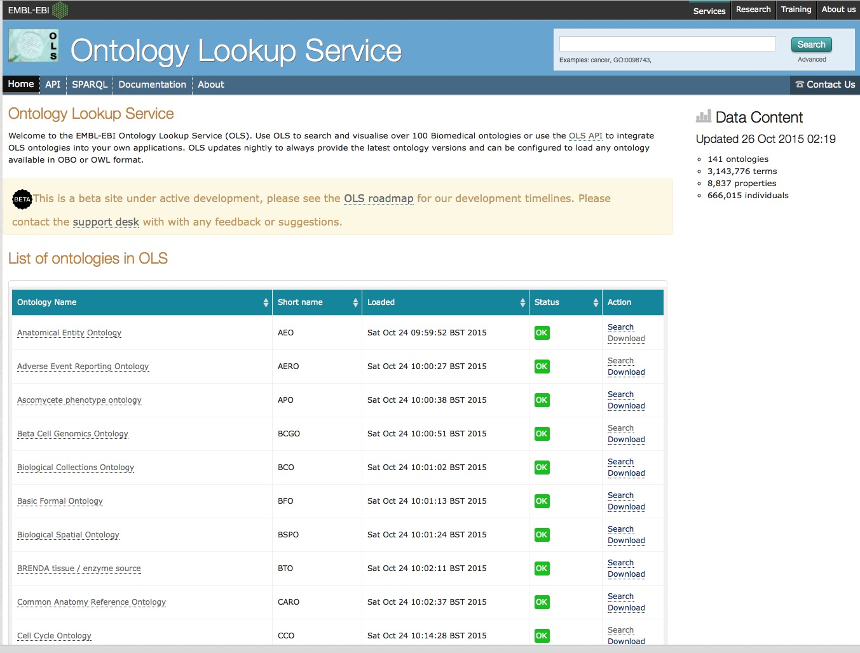
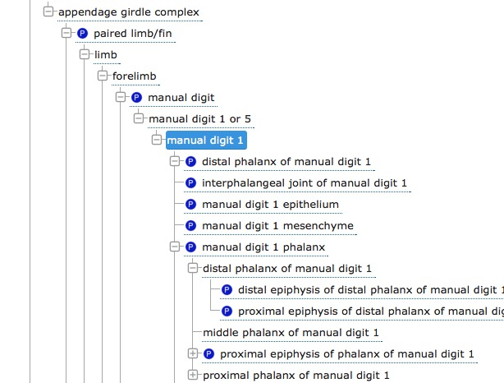
OLS 3.0 beta is now live
http://www.ebi.ac.uk/ols/beta/
147 ontologies
4.5 million terms
Generic ontology infrastructure
  Can load any OWL or SKOS file
Built with industry-standard technologies
  Solr, Neo4j, Spring IO, Thymeleaf, Bootstrap, Jquery
Includes stand-alone Spring-Boot app building local SOLR or Neo4s
Open-source project
https://github.com/EBISPOT/OLS

Slide 6
Acknowledgements
Sample Phenotypes and Ontologies Team –
Simon Jupp, Catherine Leroy, Thomas Liener, Sira Sarnitivijai, Ilinca Tudose, Olga Vrousgou, Dani Welter, Helen Parkinson
Matt Pearce – Flax (BioSOLR project)
Funding
  EU CORBEL
  EU DIACHRON Project
  EU BioMedBridges

Slide 7
OLS Bug Hunt
ols-support@ebi.ac.uk
https://github.com/EBISPOT/OLS/issues
http://goo.gl/BKVCIE
http://www.ebi.ac.uk/ols/beta

