Slide 1
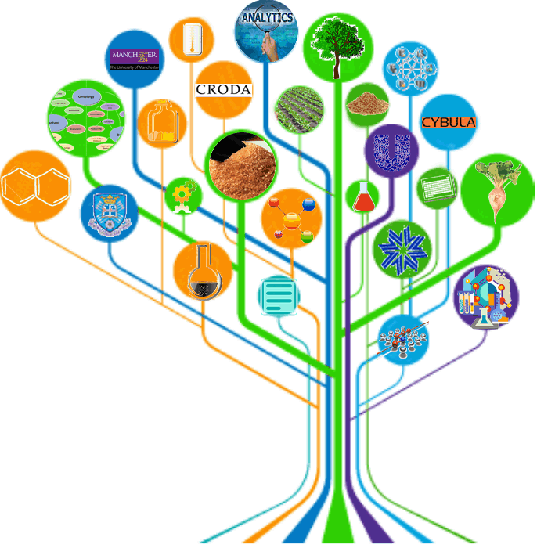
Integrating literature mining and curation for ontology-driven knowledge discovery
George Demetriou¹, Warren Read², Goran Nenadic¹,
Noel Ruddock², Martyn Fletcher³, Tom Jackson³,
Robert Stevens¹ & Jerry Winter²
¹University of Manchester, ²Unilever Research, ³Cybula Ltd.
Location: Great North Museum: Hancock, Newcastle

Slide 2
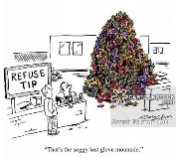
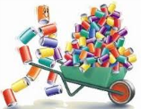


Content Curation for KBs
Lifecycle
Search for content
Collect it
Read/Analyse it
Convert it into formal representations
Integrate knowledge into computational models
Use it to produce explanations, predictions or innovations
Critical for knowledge bases
But: cannot keep up with the volume and complexity of data!
> 2 articles per min

Slide 3
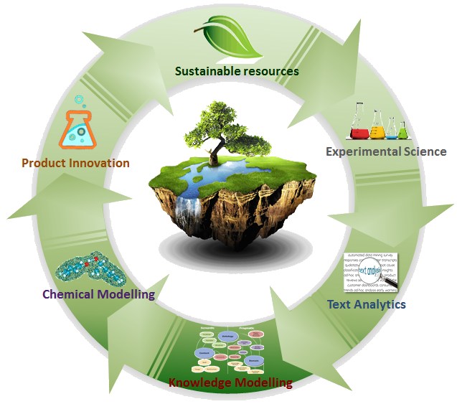
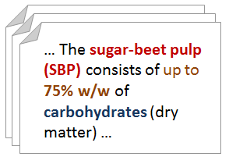

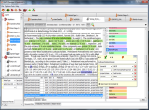
Knowledge Discovery Cycle in BioHub
Feedstocks, chemicals, plants, organisms, chemical transformations, properties
Task: Extract, organise and integrate knowledge into models of chemical engineering
“Which chemicals come from which feedstocks?”
BioHub IKMS

Slide 4
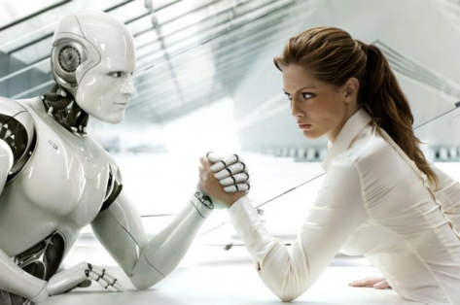
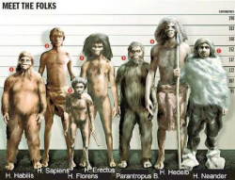

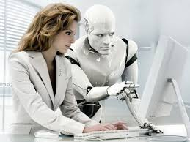
Curation: Humans vs. machines
DARPA Big Mechanism:
Comparison based on
text evidence from literature
Humans:
Machines:
Hybrids:
8%
Good for finding interactions
Bad for grounding
48%
Bad for interactions Good for grounding
73%
Humans for interactions
Machines for grounding

Slide 5

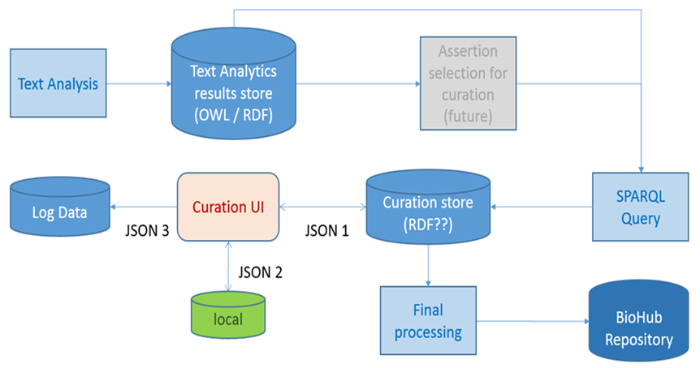
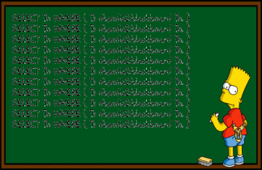

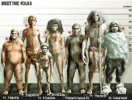
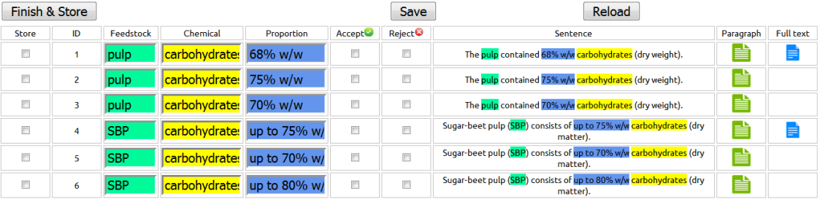
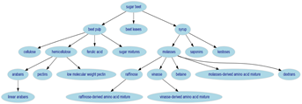
BioHub Curation Pipeline
1
2
3

Slide 6

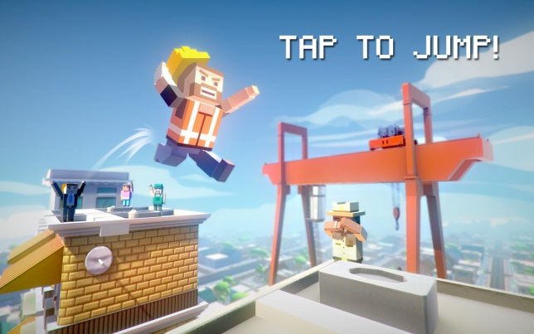
Content Curation for KBs
A leap of faith?
OR
A leap of knowledge?

