Slide 1



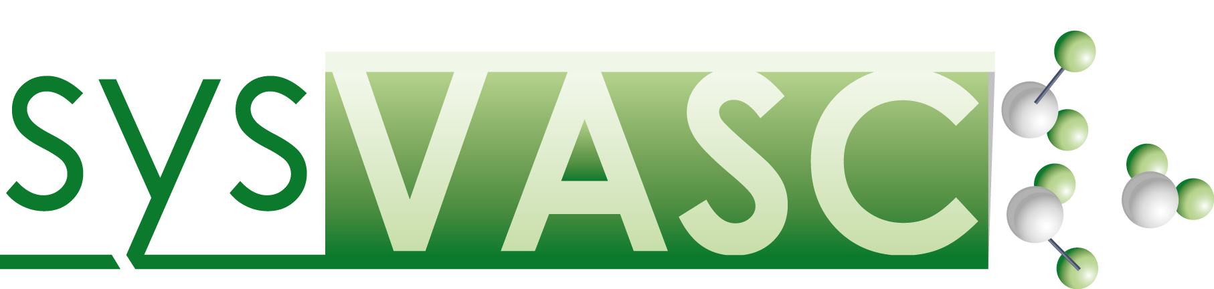
The Cardiovascular Disease Ontology
(CVDO)
Mercedes Arguello Casteleiro¹, Julie Klein² and Robert Stevens¹
¹School of Computer Science, University of Manchester, Oxford road, Manchester, United Kingdom.
²Institut National de la Santé et de la Recherche Médicale (INSERM), U1048, Toulouse, France. And Université Toulouse III Paul-Sabatier, Toulouse, France.

Slide 2
CVDKB content
34 publications (human and mouse):
10311 entries mRNAs (8423 unique)
123 entries miRNAs (107 unique)
395 entries proteins (332 unique)
48 entries metabolites (24 unique)
74 entries peptides
Challenges:
Connect the species (data: 80% human; 20% mouse)
Connect the biological level
Visual interface
mRNA
miRNA
Protein
Peptides
Metabolites

Slide 3




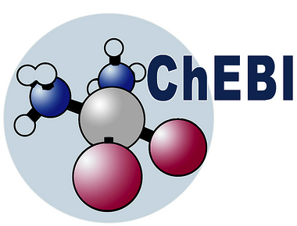
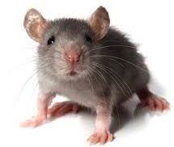
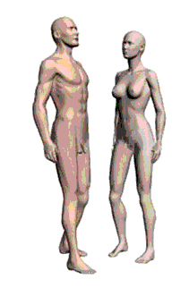
CVDKB content
mRNA
miRNA
Protein
Peptides
Metabolites
26675 metabolites
3569
miRNAs
86792
proteins
172121 proteins

Slide 4
CVDO reuse ontologies
Ontology for Biomedical Investigations (OBI)

Slide 5
CVDO reuse ontologies
Protein Ontology (PRO)
Sequence Ontology (SO)
Gene Ontology (GO)
Chemical Entities of Biological Interest Ontology (ChEBI)
NCBI Taxonomy Ontology
Cell Ontology (CL)
Uber Anatomy Ontology (UBERON)
Phenotypic Quality Ontology (PATO)
Relationship Ontology
Ontology for Biomedical Investigations (OBI)

Slide 6

New CVDO application
Converting OWL to JSON-LD @context
OWL
(ontologies)
SPARQL
(queries)
SOLR
elasticsearch
LUCENE

Slide 7

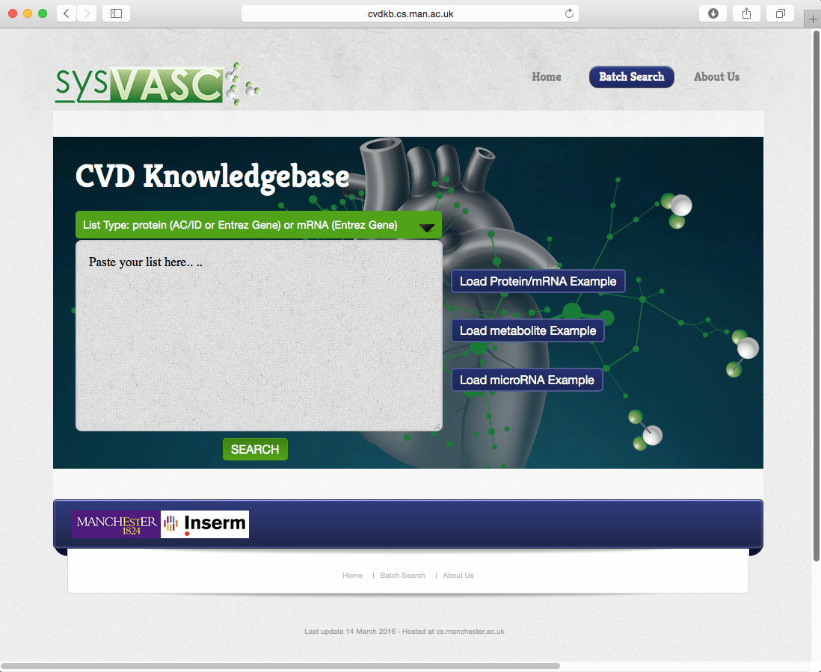
cvdkb.cs.man.ac.uk

Slide 8
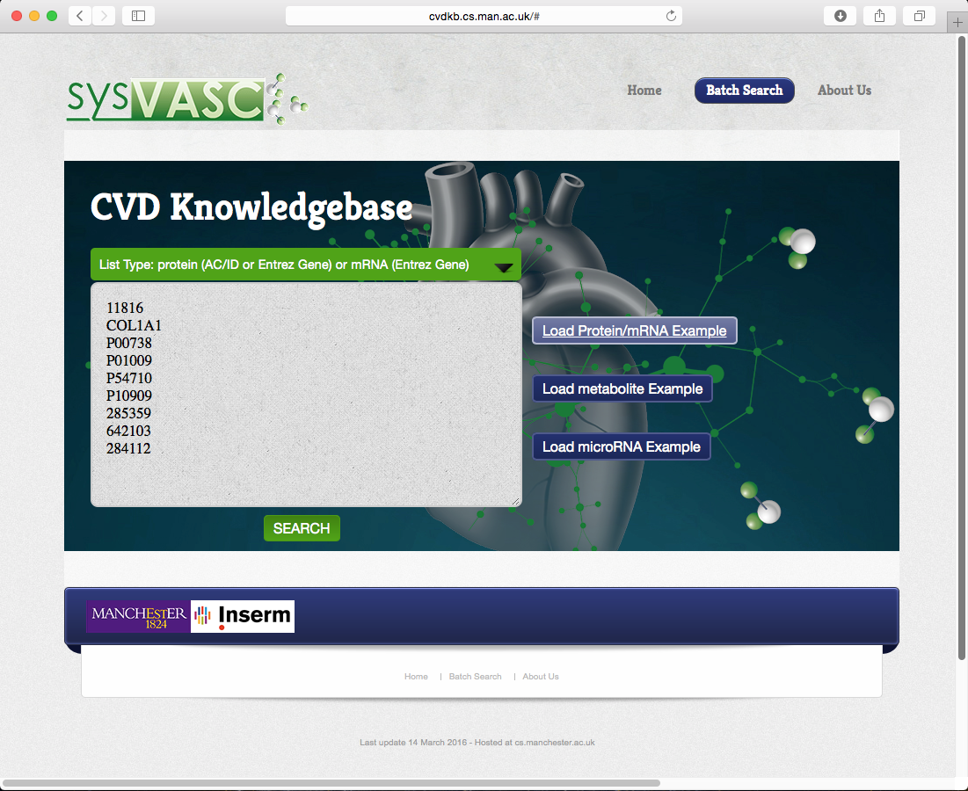
cvdkb.cs.man.ac.uk

Slide 9
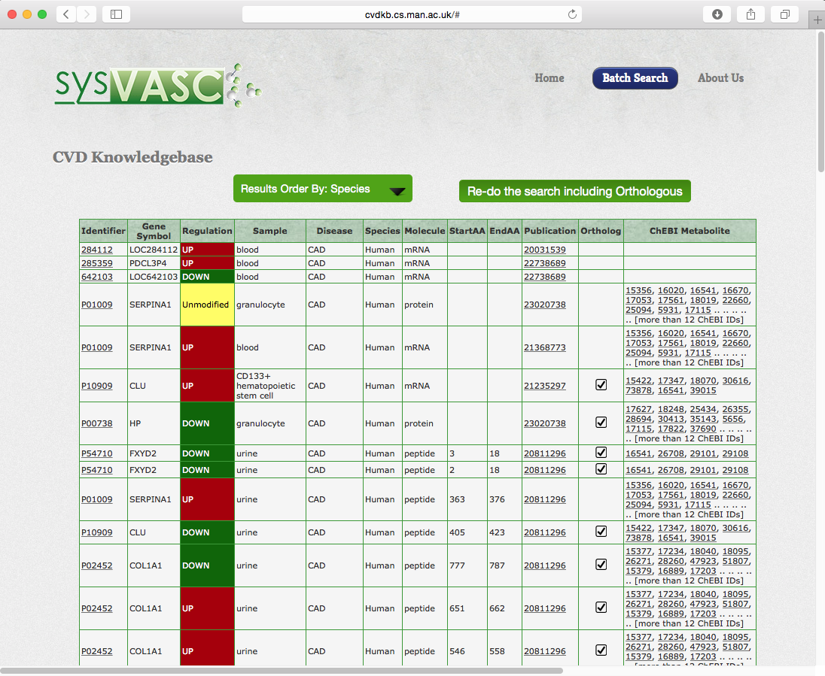
cvdkb.cs.man.ac.uk

Slide 10
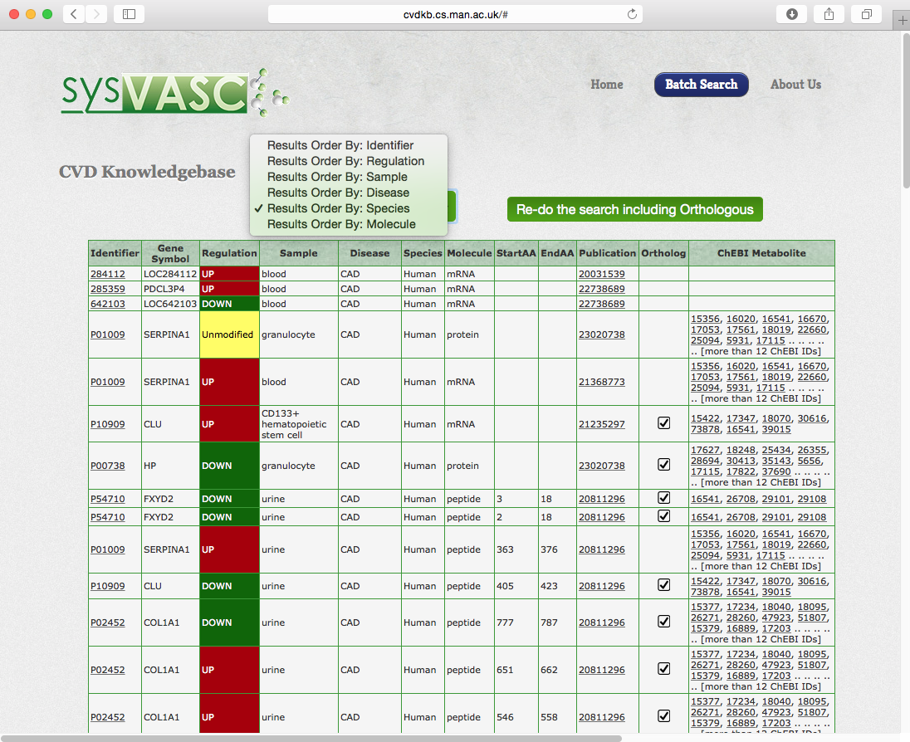
cvdkb.cs.man.ac.uk

Slide 11
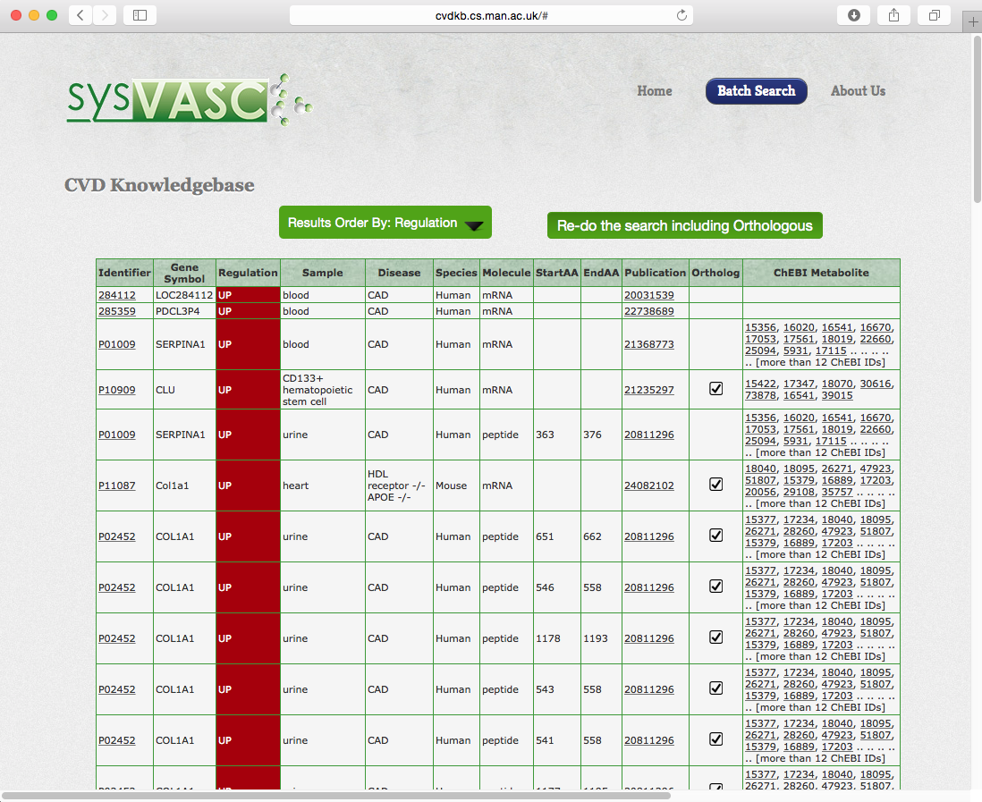
cvdkb.cs.man.ac.uk

Slide 12
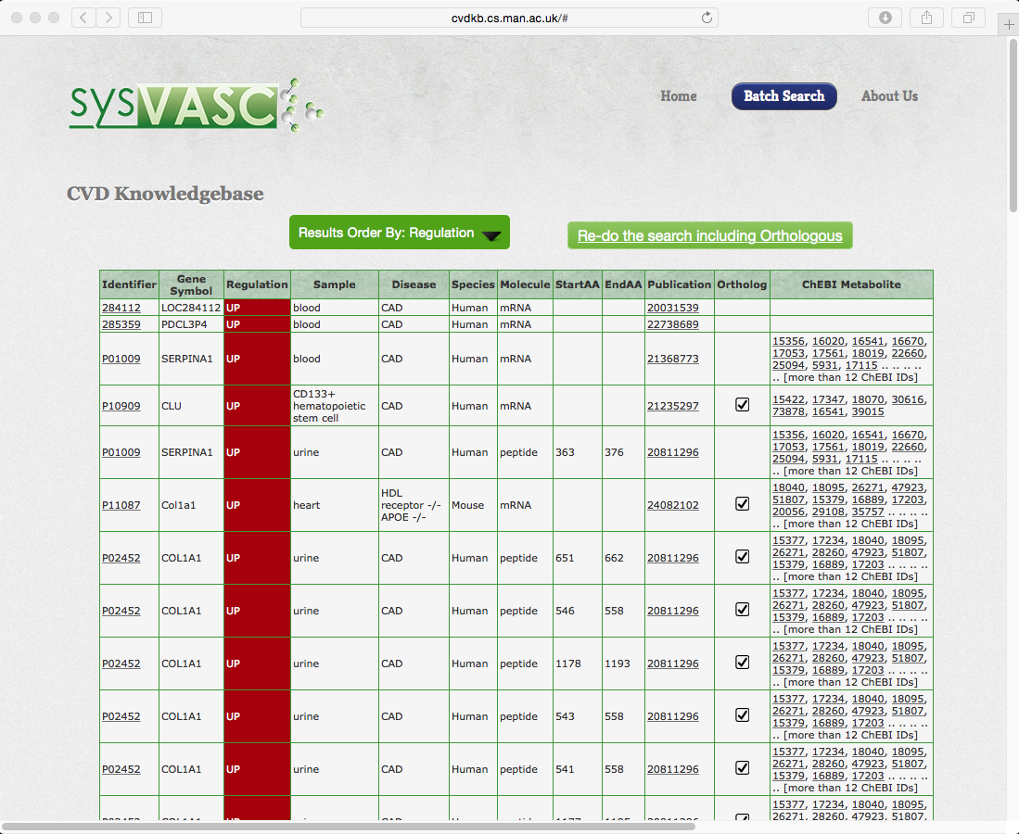
cvdkb.cs.man.ac.uk

Slide 13
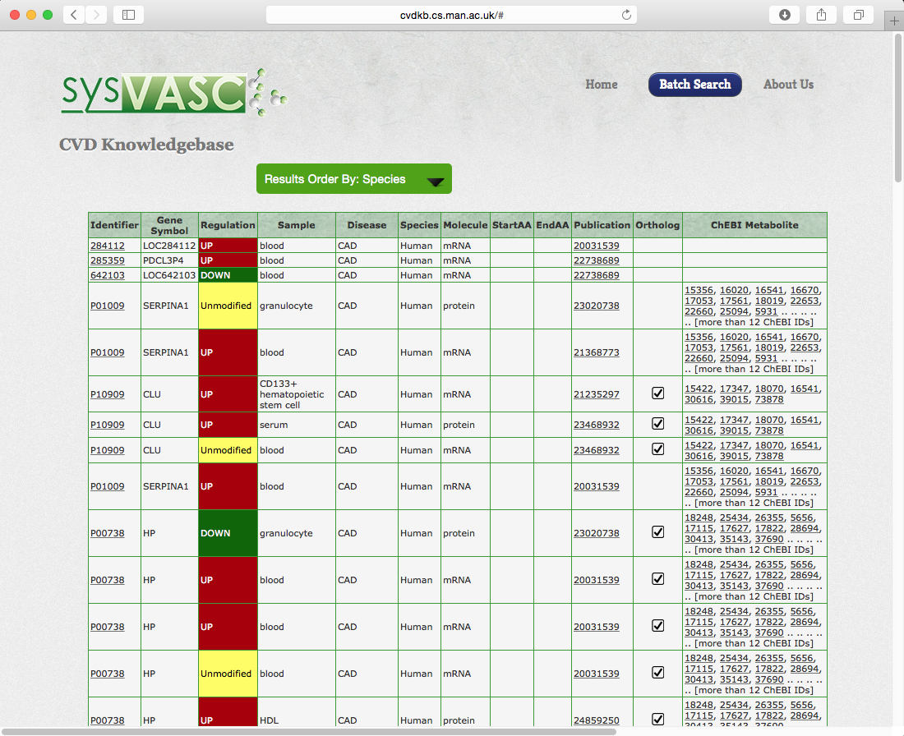
cvdkb.cs.man.ac.uk

Slide 14



